Slide 1
Employee Data Analysis using Excel
STUDENT NAME: JEVASRI R S
REGISTER NO: 312216955
DEPARTMENT: B COM (GENERAL)
COLLEGE: SHRI KRISHNASWAMY COLLEGE FOR WOMEN

Slide 2
PROJECT TITLE
Employee salary Analysis using Excel

Slide 3


AGENDA
Problem Statement
Project Overview
End Users
Our Solution and Proposition
Dataset Description
Modelling Approach
Results and Discussion
Conclusion
3/21/2024 Annual Review

Slide 4

PROBLEM STATEMENT
The objective of this analysis is to systematically
examine and delineate salary distribution across various departments, considering both genders and different roles within the organization.
Currently, the data concerning employee salaries is presented in an unstructured format.
This data needs to be organized and categorized based on similarities to yield accurate and actionable insights regarding employee compensation

Slide 5

PROJECT OVERVIEW
Objective:
The primary goal of this initiative is to systematically gather and organize employee salary data across various departments. This effort aims to facilitate comparisons of compensation levels between departments and identify areas for potential adjustments to mitigate pay disparities within the organization.
Purpose:
This project will provide the Human Resources (HR) team with the necessary insights to make informed decisions that align with organizational objectives, thereby fostering a fair and competitive work environment

Slide 6


WHO ARE THE END USERS?
Human Resources Professionals
Role: Manage employee data and track salaries.
Use: Oversee compensation records and ensure data accuracy
Financial Analysts
Role: Analyze salary expenses, budgeting, and forecasting.
Use: Assess financial impact of salaries and predict future budget needs.
Accountants
Role: Ensure accurate financial reporting and compliance with accounting standards.
Use: Maintain precise records and adhere to financial regulations.
Payroll Managers
Role: Ensure accurate salary payments, deductions, and compliance with tax laws.
Use: Process payroll accurately and handle deductions and tax compliance.

Slide 7
OUR SOLUTION AND ITS VALUE PROPOSITION
Highlighting
Purpose: Emphasize critical data points for enhanced focus during analysis.
Benefit: Directs attention to significant metrics, facilitating targeted insights.
Pivot Tables
Purpose: Organize and summarize data into a structured format of rows and columns.
Benefit: Provides a clear, dynamic view of large datasets, enabling efficient classification and comparative analysis.
Graphs
Purpose: Present data in visual formats such as charts and graphs.
Benefit: Enhances clarity and interpretation of complex data through visual representation.
Filtering
Purpose: Isolate and view subsets of data based on specific criteria.
Benefit: Enhances precision and relevance of analysis by consolidating similar data under defined categories.

Slide 8
Dataset Description
Source of Dataset:
Platform: Kaggle
2.Total Features in Dataset:
Number: 26
3.Features Selected for Salary Analysis:
Total Features:7
Employee ID – Numerical Value Name of the employee’s – Text format Employee Status - Text format Department - Text format Employee Salary - Numerical Value Employee type - Text format Start Date - Numerical Value

Slide 9

THE "WOW" IN OUR SOLUTION
Data Input: Acquire and sanitize salary data.
Organization: Utilize tables and enforce data validation.
Formulas: Apply functions such as SUM, IF, and VLOOKUP.
Pivot Tables: Aggregate and analyze data with PivotTables.
Analysis: Implement conditional formatting and scenario analysis tools.
Models/Dashboards: Develop forecasting models and visualize data trends.
Automation: Employ macros or VBA for process automation.
Reporting: Design interactive reports and dashboards.
3/21/2024 Annual Review
9

Slide 10
MODELLING
Define Goals: Identify analysis objectives
• Prepare Data: Structure data with necessary fields.
• Create Model: Use Excel Tables and relationships.
• Design Calculations: Apply relevant formulas.
• Pivot Tables: Summarize and analyze data
10

Slide 11
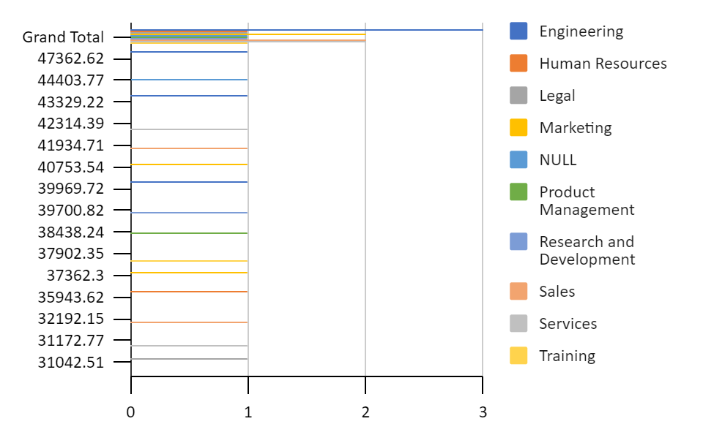
RESULTS
11

Slide 12
RESULTS
Compensation Range Compression
Market Salary Discrepancies
Internal Compensation Equity Issues
Departmental Salary Allocation
Performance-Driven Compensation Adjustments
Salary Grade Consistency
Regulatory Compliance Risks

Slide 13
conclusion
Excel data modeling for salary and compensation analysis facilitates effective management and insightful evaluation of compensation data. By utilizing structured datasets, advanced analytical formulas, and comprehensive visualization tools, organizations can:
Enhance Data Management: Streamline the organization and cleaning of salary data.
Apply Advanced Formulas: Utilize sophisticated functions for precise analysis and benchmarking.
Leverage Visualization Tools: Employ charts and graphs to interpret and present salary trends and patterns.
In summary, Excel provides a robust platform for detailed salary analysis, enabling organizations to refine and optimize their compensation strategies with greater accuracy and efficiency.

